Slide 1

Carbon

Slide 2


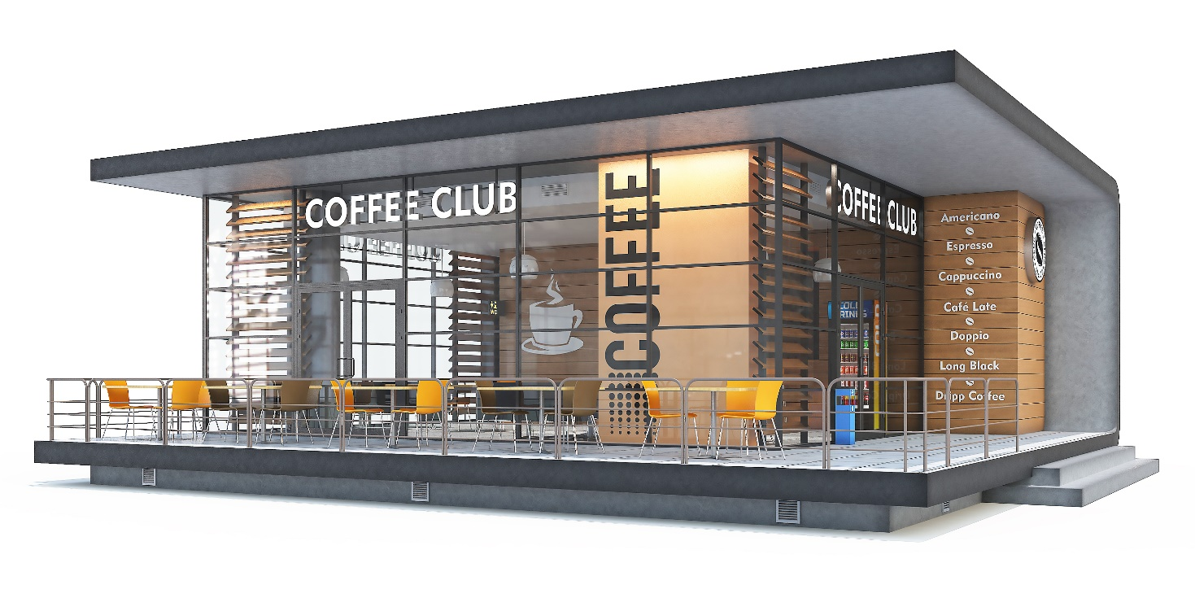




Please help my café to become carbon neutral.
First, learn how to work out where CO₂ emissions come from, with a simple example.
Then, move on to working out all the CO₂ emissions of the café.

Slide 3


In this lesson, you will:
Apply your knowledge of Earth’s atmosphere
Use the Detect-Recall-Solve process for solving problems

Slide 4

We live in a world of fast fashion. 100 billion garments are made every year. Most end up being thrown away.
Click for video
India
Fabric offcuts thrown away
Fabrics transported to clothes factory
Fabrics manufactured
Clothes made
In Europe
Clothes worn a few times
Clothes transported to shops
Clothes thrown away
What are the CO₂ emissions of fast fashion?

Slide 5
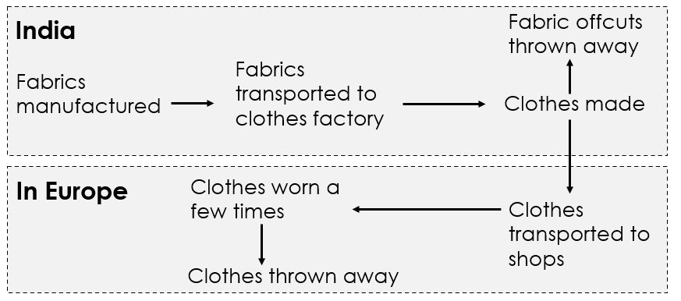
This means working out what you need to do to answer the question.
Diagram
The flow chart shows the stages in fast fashion.
Unknown
For each stage, we need to work out where CO₂ is emitted and why.
Concept
So, the concept we need to use is Earth’s atmosphere.

Slide 6
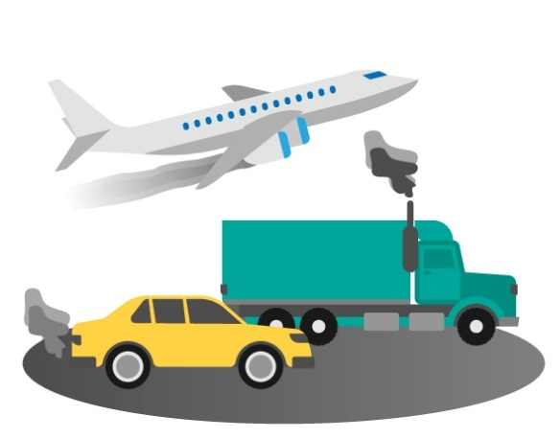

This means thinking about what you already know.
There are three main sources of CO₂:
1. Vehicles
Burning fuels like petrol or diesel releases carbon dioxide.
This is a combustion reaction:
Fuel + oxygen →
carbon dioxide + water
CO₂
CO₂
CO₂
Why is combustion an example of oxidation?

Slide 7
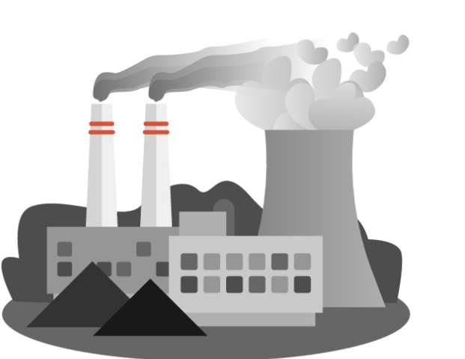
2. Electricity
Burning fuels in power stations releases carbon dioxide. The UK uses coal, gas and biomass (like wood).
In newly industrialised countries like India and China they mostly burn coal to generate electricity.
CO₂
CO₂
CO₂
CO₂
Why is the UK closing down coal power plants?

Slide 8
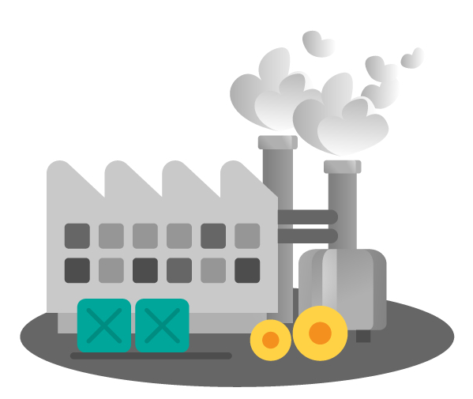
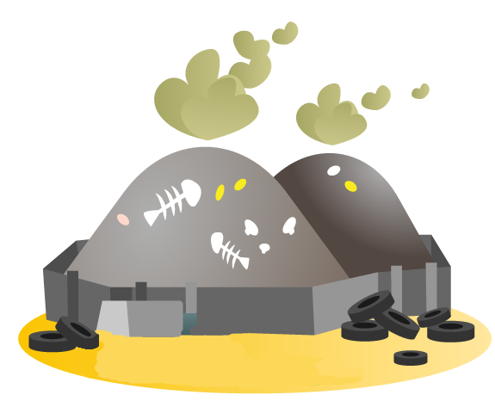
3. Waste
When rubbish decays in landfill or is burnt in incinerators it releases carbon dioxide.
CO₂
CO₂
CO₂
CO₂
CO₂
CO₂
CO₂
CO₂
CO₂
CO₂
CO₂
Why do decomposers (organisms that carry out decay) release carbon dioxide?

Slide 9

This means using what you know to answer the question.
We know that CO₂ is released when materials burn in:
power stations
vehicle engines
incinerators.
And when rubbish decays in landfills.
Now we look for these in the stages of fast fashion.

Slide 10
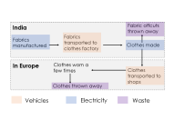
Answer:
Vehicles for transporting fabrics and clothes burn petrol and diesel, which releases CO₂.
Click to zoom
Factory machines for fabrics and clothes use electricity. When electricity is generated by burning fossil fuels it releases CO_{2.}
Fabric offcuts and clothes are thrown away. They are burnt, which releases CO_{2,} or put into landfill, which releases CO₂ when they decay.

Slide 11


Now you’re ready to start helping the café, by identifying their CO₂ emissions.
Activity: Identify the CO₂ emissions of the café SS1-4
There are 4 areas to look at: staff transport, goods transport, electricity and waste. Take one per pair.
Discuss what creates CO₂ emissions.
Decide what produces the most CO₂ and why.
Share what you found out in a group.
Finally, work alone to explain all the ways the café emits CO₂.

Slide 12
Carbon
Student sheets

Slide 13





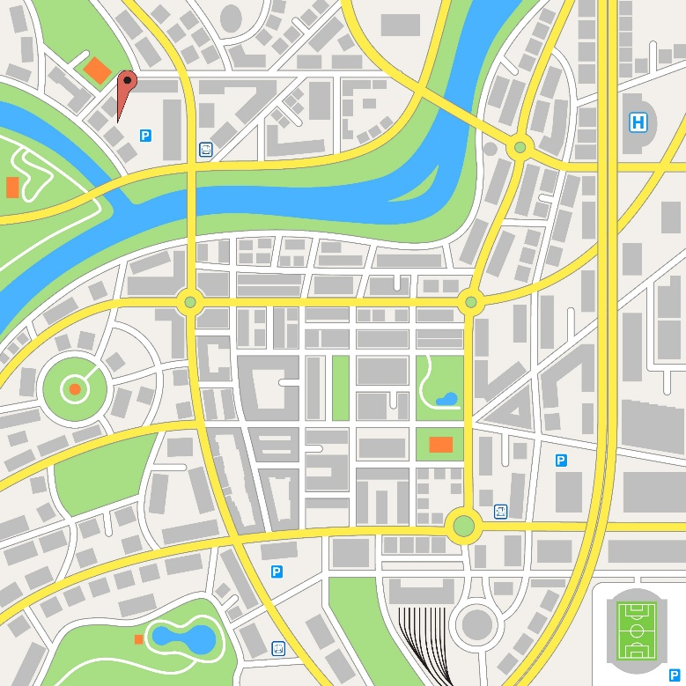

Transport (staff)
SS1
Our people have to travel to the café. They use different types of transport. The map shows the location of the café.
Discuss:
Why does transport produce CO₂ emissions?
Which person’s transport produces most CO₂? Why?
Town map
Staff
Name | Rose | Billy | Ren | Maria | Femi
Position | Owner | Assistant manager | Supervisor | Barista | Barista
Hours per week | 40 | 35 | 20 | 12 | 6
How far they live from the café | 7.5 km | 6 km | 5 km | 10 km | 1.5 km
How they get to work | Train | Drive (petrol car) | Bus | Drive (petrol car) | Walk
Café
Train station
Bus stop
100 m

Slide 14
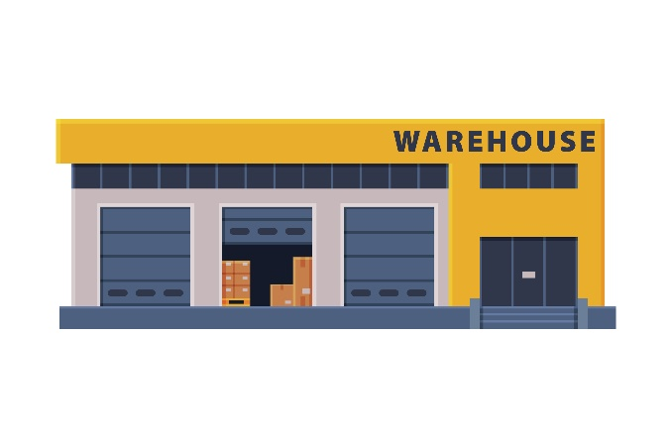
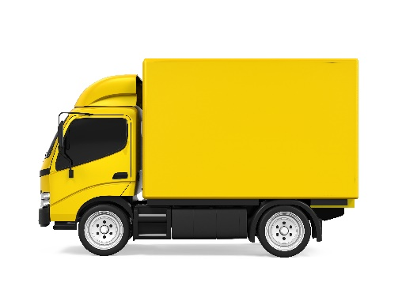
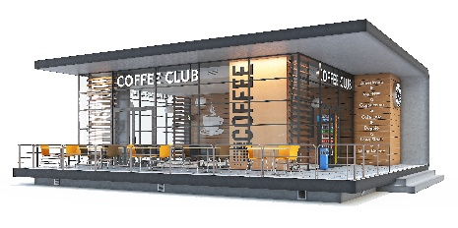

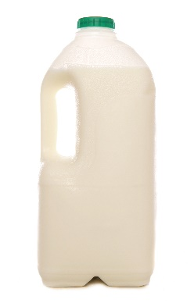
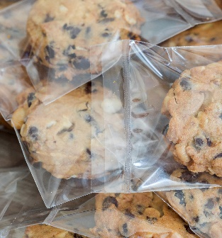
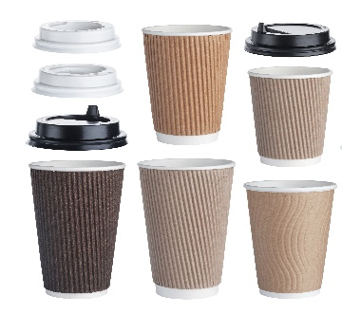
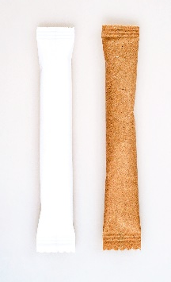
Transport (goods)
SS2
Goods for the café are delivered from a wholesaler who is 10 km away.
Goods are delivered once per week by lorry.
Discuss:
Why does transporting goods produce CO₂ emissions?
Which good produces most CO₂ emissions when it’s transported? Why?
Goods delivered every week
Coffee beans from Brazil
(9000 km away)
Milk from farms across the UK
(20 – 400 km away)
Pre packaged cakes and biscuits from UK factory
(260 km away)
Cane sugar from Belize (8000 km away)
Cups and lids from a UK manufacturer (108 km away)

Slide 15
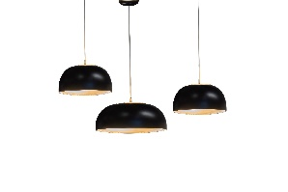
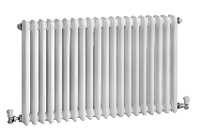
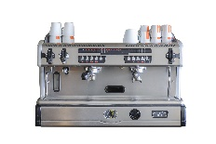
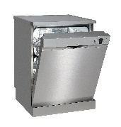
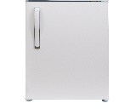
Electricity
SS3
The café buys its electricity from a supplier. They buy electricity from all the different power stations in the country. These include nuclear, biomass and fossil fuel power plants, wind farms and solar panels.
Discuss:
Why do electrical appliances produce CO₂ emissions?
Which appliance produces most CO₂ emissions? Why?
Unit (kWh) =
Power (kW) x time (hour)
Each units costs 15p
Appliance | Power in kW | Time it is used for (average per month in hours) | Average number of units used per month | Cost to run per month
Lighting | 1.6 | 240 | 384 | £57.60
Heating | 2.5 | 100 | 250 | £37.50
Coffee machine | 3.8 | 180 | 684 | £102.60
Dishwasher | 1.8 | 90 | 162 | £24.30
Fridge | 0.2 | 720 | 144 | £21.60

Slide 16

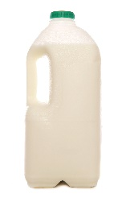


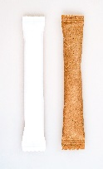
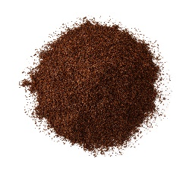

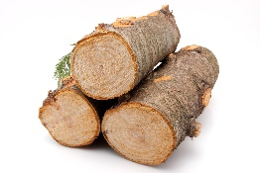

Waste
SS4
Our paper cups and empty milk cartons are recyclable. The cafe has recycling bins. Most waste is sent to landfill or burnt in an incinerator. Customers also take used cups out of the the building and throw them away.
Discuss:
Why does waste produce CO₂ emissions?
Which waste from the café produces most CO₂ emissions? Why?
Waste per week
Five empty plastic bags
50 plastic bottles
300 plastic wrappers
750 paper wrappers
1000 paper cups and plastic lids
Recycling (lower carbon footprint)
Making new product from raw materials (higher carbon footprint)
Product
10 kg of coffee grounds
Raw material (wood)
Product
Paper pulp

Slide 17
Assessment rubric
Score | Level | Description | Example of a typical student response for one part of the answer
1 | No link | Relevant ideas | “Two of the staff drive cars, and these release carbon dioxide.”
2 | Partial link | Relevant ideas with simple connections | “Two of the staff drive petrol cars to get to the café. Inside the engine, petrol is burnt which releases carbon dioxide.”
3 | Full link | At least two ideas logically connected. Use of some scientific language. | “Two of the staff drive petrol cars to get to the café. Inside the engine, petrol is burnt which is a combustion reaction. Carbon dioxide is one of the products of this reaction. Other forms of transport the staff use incudes buses and trains, which also release carbon dioxide.”
4 | Extended link | Several ideas connected with scientific reasoning. May link to other concepts. Use of accurate scientific language. | “Two of the staff drive petrol cars to get to the café. Inside the engine, petrol is burnt which is a combustion reaction. Carbon atoms in the petrol molecules are oxidised to produce carbon dioxide. Other forms of transport the staff use incudes buses and trains, which also release carbon dioxide. However, as they are sharing the transport with many others the amount of CO₂ emitted per person is lower than if you drive a car alone. One staff member walks. This is the only form of transport that does not release carbon dioxide.”

Slide 19
Vehicles
Electricity
Waste

